Slide 1
Pico 2021 Annual Meeting
Happy Cinco de Mayo!
Notes:
`

Slide 2
Agenda
Sharon Town Lee, PIO Chair (10 min) Opening Statement and Introduction of Mayor Himmelrich, Board Members & City Staff ​
Perfect Margarita Demo &$100 Lares Gift Card Giveaway
Recognize New Business Owners
Mayor of Santa Monica, Sue Himmelrich (5 min)
Sharon Town Lee State of the Boulevard and Financial Report ​(10 min)
Dana Moorehead, PIO Marketing Director 2021 Pico Marketing Plans (5 min)
David Ruiz, PIO Secretary
Election of PIO Board of Directors
Sharon Town Lee
Thank you to Donna Gentry
Magic Paintbrush Award

Slide 3
New Pico Merchants
In2 Deep Diving
Reform Kitchens
Indo-Asian Market
Art Studio for Kids

Slide 4
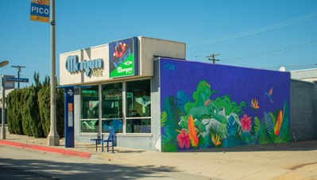
2020 PICO Achievements
Pico Pop Up
Transformed an empty storefront into a merchant photo gallery. Now rented and an Art Studio.
Added Streetlight Banners
Expanded Pico placemaker streetlight banners from 50 to 85 poles.
Pico Most Loved Businesses Promotion 2020
Leveraged Most Loved Contest into a 3 month-long dedicated Merchant Prize Giveaway/Promotion, with flyers, social media promotion, which drove registration to PicoPassport.com - adding nearly 300 new Pico community subscribers to dedicated email list
Holiday Promotion
Had Pico's first ever Wishing Tree and Holiday Light Deco in our first ever Pico Pop Up!
Added A Mural
Morgan West Wall
Halloween Celebration
Pico Pop Up safely offered Pico families a Halloween Costume Contest and
candy giveaway.
Valentine’s Day Promotion
Partnered with VAP for a Valentine Light display that garnered tremendous
community positive feedback and promoted merchant gift cards.

Slide 5
2021 PICO Marketing & Beautification
New Pico Pop Up - Art Gallery
Transforming a second empty storefront into an art gallery starring Pico artists. Opening June 4 with press and fanfare, featuring mural maps, merchant sales collateral.
Brand New Streetlight Banners
Planning implementation before Holiday 2021
Messaging of Murals and Welcome to Historic Pico Blvd
Pico Most Loved Businesses Promotion 2021
We will leverage contest winners beginning in June with a full page ad in SMDP and start a multi-platform campaign and prize giveaway through summer.
Holiday Promotion
We plan a Holiday Wishing Tree and Colorful Light Display at VAP
More Murals
We are partnering with Beautify Earth to paint the Morgan-Wixson Theatre side wall
More murals planned
Santa Monica Shines – Street Clean Up
Leading a block by block trash cleanup up and sidewalk power wash campaign.

Slide 6
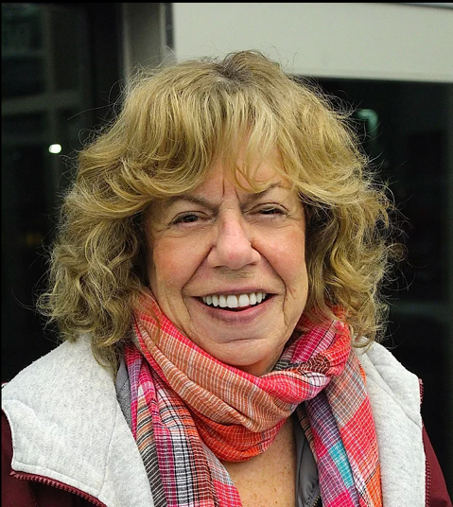
Thank You, Donna Gentry

Slide 7
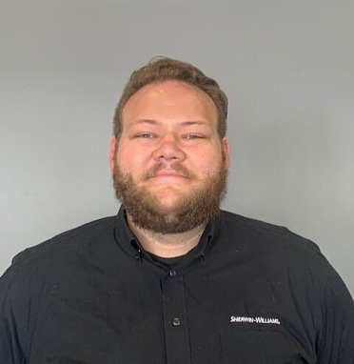
2021 Pico Magic Paintbrush Award Sam Bjoraker GM, Sherwin-Williams Paint Store

