Slide 1
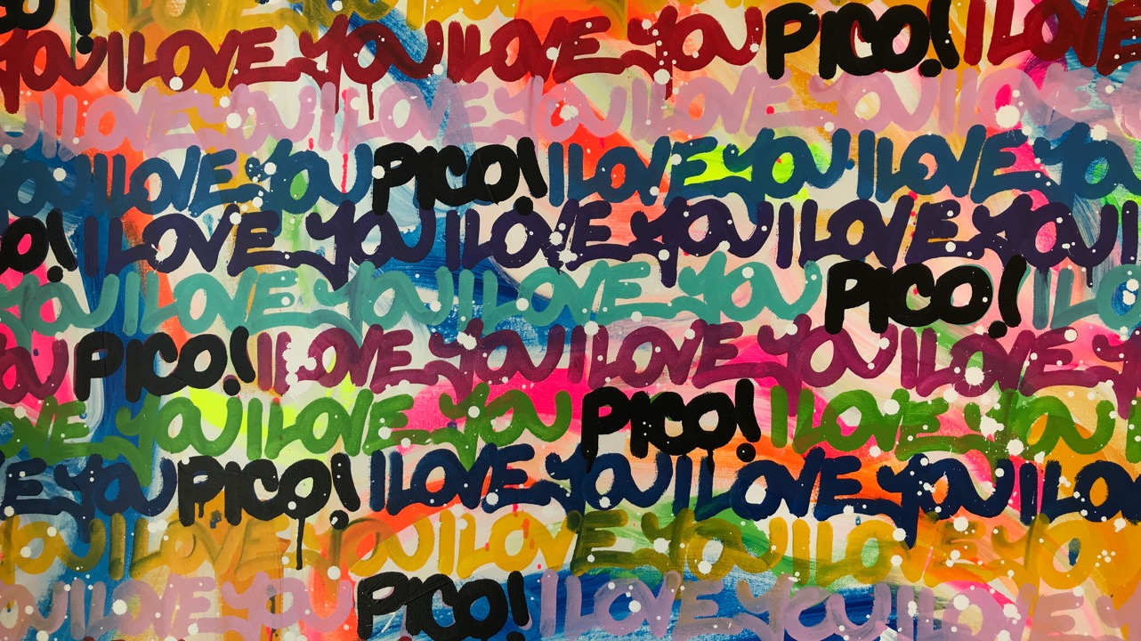
Pico 2022 Annual Meeting
Notes:
`

Slide 2
Agenda
Sharon Town Lee, PIO Chair (2 min) Opening Statement and thank you to our hosts
McCabe’s new manager Walt McGraw
Concert Diretor TomZehhnder
The Lawrence Lebo Trio
Sharon Town Lee State of the Boulevard and Financial Report ​(2 min)
Dana Moorehead, PIO Marketing Director 2021 Pico Marketing Plans (2 min)
David Ruiz, PIO Secretary
Election of PIO Board of Directors

Slide 3
New in 2022 Pico Merchants
Prime Pizza
Intuition Skate
Adriana’s Hair Studio
Creative Crossroads
Nostaligia Bar & Lounge
Pico Culture House

Slide 4
2022 PICO Marketing & Beautification
New Pico Pop Up - Pico Culture House Opening July 2022
Transforming a third empty storefront into an an artistic space for poetry, art installation, storytelling.
Brand New Pico Mural on InterDental Building
Two strories high and lit at night, generated press coverage and community compliments
Adopted the Pico Centinela Off Ramp
Litter Clean Up monthly
Vibrant, colorful drought garden to be planted in July 2022
Pico Volunteer Litter Crew – Street Clean Up
Will keep Leading a block by block trash cleanup up
A Door to Adore Program
Cohesive pops of color coordinated with the Pico Mural on Merchant doors and trim
Affordable Power Wash Service and sidewalk power wash campaign
Pico Most Loved Businesses Promotion 2022
We will leverage contest winners beginning in June with a full page ad in SMDP and start a multi-platform campaign through summer.
Holiday Promotion
We plan a Holiday Wishing Tree and Colorful Light Display at VAP
Pico Podcast
Coming Summer 2022 from the Pico Farmer’s Market – rotating guests & merchants from Pico share advice and tips

